Slide 1


PROJECT PRESENTATION on Examination Duty Allotment and Management System
Department Of Computer Applications
St Joseph Engineering College
Mangalore - 575028
Under the Guidance of
Internal
Ms Nishmitha J Assistant Professor
Department of Computer Application SJEC
External
Priyadarshini P Assistant Professor
Department of Computer Application SJEC
Praneeth Kumar
4SO23MC071
MCA-B

Slide 2
Company Profile
Softionik is a leading IT and software solutions provider based in Mangalore, India. The company specializes in mobile app development, web solutions, cloud services, IT security, and custom software for various industries. With expertise in modern technologies like Node.js, Angular, Python, Java, and IoT, Softionik has successfully delivered over 120 projects in its 7+ years of operation. Known for its innovation, quality service, and timely delivery, the company focuses on empowering businesses with reliable technology solutions. Located at Dwaraka Complex, Balmatta, Mangalore, Softionik is dedicated to serving clients with professionalism and excellence.

Slide 3
Introduction
The Examination Duty Allotment System is a web-based platform designed to streamline and automate the process of assigning examination duties to faculty members in educational institutions. The system enables administrators to efficiently create exams, manage exam dates, and allocate or allow faculty to select their preferred duty slots. With secure authentication, role-based access, and automated notifications, the platform reduces manual workload, minimizes scheduling conflicts, and ensures transparency in duty assignments. The system also provides comprehensive reporting and history tracking for both administrators and faculty.

Slide 4
Introduction to SRS & Project Scope
Purpose
Scope
The primary purpose of the Examination Duty Allotment System is to streamline and automate the assignment of examination duties to faculty members in educational institutions. Traditionally, this process is manual, time-consuming, and prone to errors or conflicts. By digitizing the process.
Reduce administrative workload
Ensure fairness and transparency
Allow faculty members to indicate their availability and preferences
Provide timely notifications and reminders
Maintain a historical record
The Examination Duty Allotment System enables secure login for admins and faculty, provides role-based dashboards, and streamlines the creation and management of exams and duty assignments. Admins can assign duties or allow faculty to select slots, while faculty can view and choose their preferred exam duties. The system automates notifications, supports reporting, and ensures a user-friendly, responsive experience for efficient and transparent exam duty management.

Slide 5
Functional Requirements
User Authentication:
Secure login for Admin and Faculty.
Password reset via email.
Admin Features:
Create and manage exams and exam dates.
Add, update, and delete faculty records.
Assign duties manually or allow faculty to select slots.
Generate and download duty reports.
Faculty Features:
View available exam dates and slots.
Select preferred duty slots.
View assigned duties and history.
Notifications:
Email reminders for duty selection and assignments.

Slide 6
Non-Functional Requirements & Constraints
Usability:
Intuitive, responsive web interface (React + Tailwind CSS).
Performance:
Fast response times for all user actions.
Security:
Passwords stored securely (hashed).
JWT-based authentication.
Reliability:
Data consistency ensured via transactional operations.
Scalability:
Designed to support multiple departments and large user bases.
Constraints:
Requires internet connectivity.
Relies on institutional email for notifications.
Backend must be hosted with access to a MySQL database.

Slide 7
Tools and Technology Used
Frontend
React.js: Builds dynamic, interactive UIs.
Tailwind CSS: Clean, responsive design with utility classes.
Vite: Lightning-fast builds & dev server for React.
Backend
Node.js: Server-side JavaScript engine.
Express.js: Handles routing & API logic.
Database
MySQL: Manages structured data like users, exam schedules, and duty records.
AI Integration
TinyLLaMA Model: Runs locally to generate official duty emails with privacy-focused AI.
Development & Deployment
Postman: API testing tool.
Git & GitHub: Version control and collaboration.

Slide 8
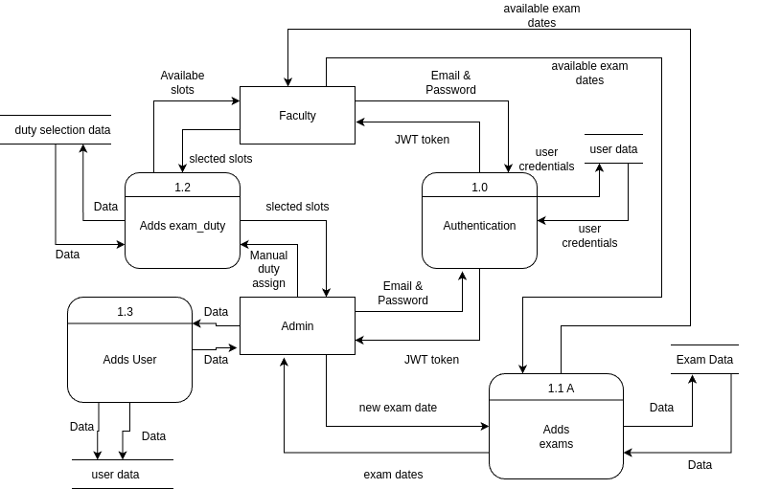
Data Flow Diagram

Slide 9
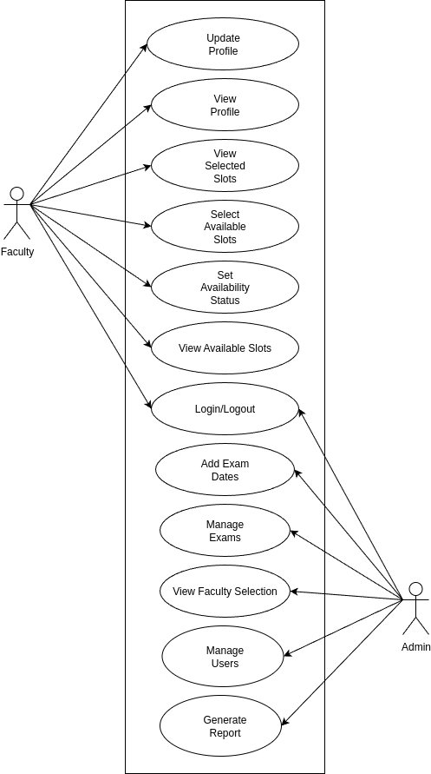
Use Case Diagram

Slide 10
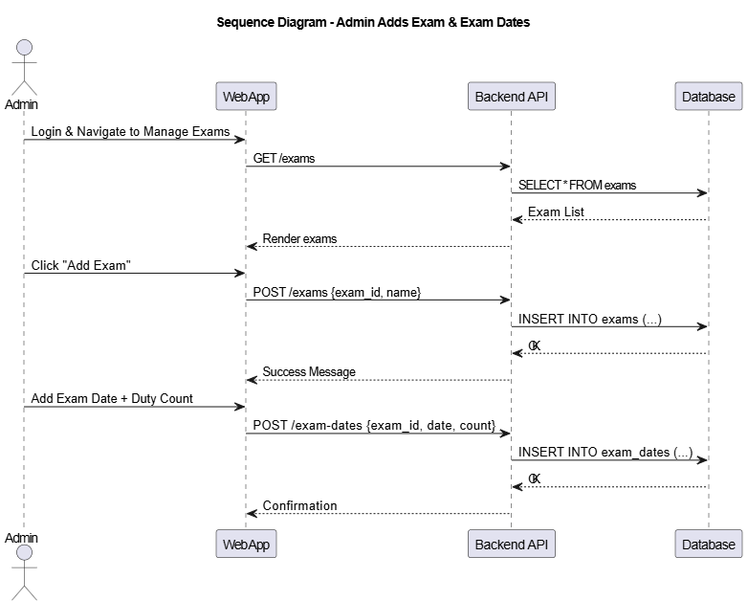
Sequence Diagram

Slide 11
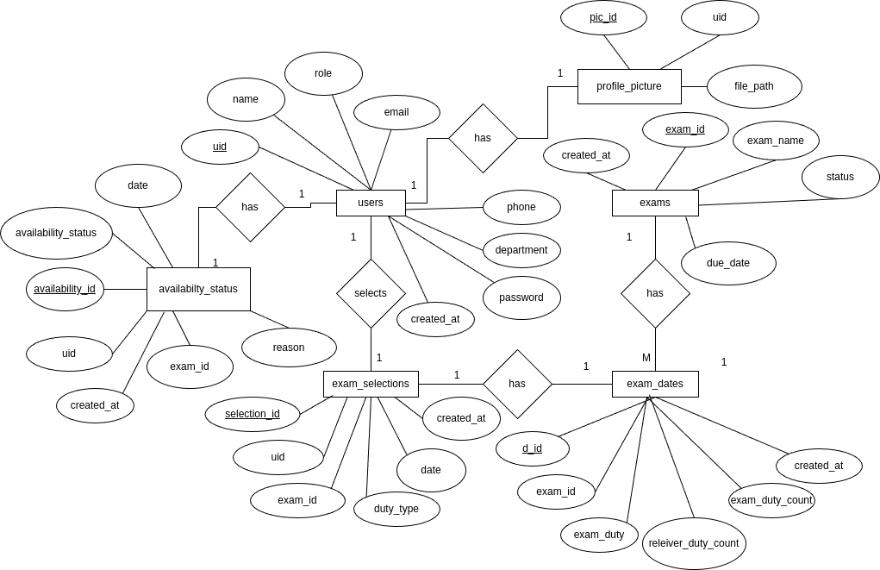
ER Diagram

Slide 12
Testing
Unit Testing
Individual modules and functions (such as authentication, user management, and exam assignment logic) were tested in isolation to ensure each component works as intended. Example: Testing the login function to verify correct and incorrect credentials.
Integration Testing
Multiple components were tested together to ensure they interact correctly. Example: Testing the full flow from user login, exam creation, to duty assignment and notification.
Test Coverage
Authentication and authorization logic
Exam and duty management workflows
Database operations and data consistency
Email notification triggers

Slide 13
Implementation
Role-Based Access Control
Users are assigned roles (admin/faculty) and can only access features relevant to their role, ensuring security and data privacy.
Duty Assignment Logic
Manual Assignment: Admins can directly assign duties to faculty.
Self-Selection: Faculty can select available slots; the system checks for slot availability and prevents double-booking.
Conflict Prevention: The backend checks for duplicate or conflicting assignments before saving.
Email Notification System
Automated emails are sent for password resets, duty assignments, and reminders using Nodemailer.
Database Transactions
Critical operations (like duty assignment) use transactions to ensure data consistency and prevent partial updates.
Responsive UI
The frontend uses React and Tailwind CSS to provide a seamless experience across devices.

Slide 14
Conclusion
The Examination Duty Allotment System simplifies and automates the exam duty assignment process, reducing manual errors and workload. With role-based dashboards, automated notifications, and clear reporting, it ensures transparency, fairness, and efficient management of exams and faculty duties. The system provides a secure, user-friendly solution that meets institutional needs for modern duty management.

Slide 15
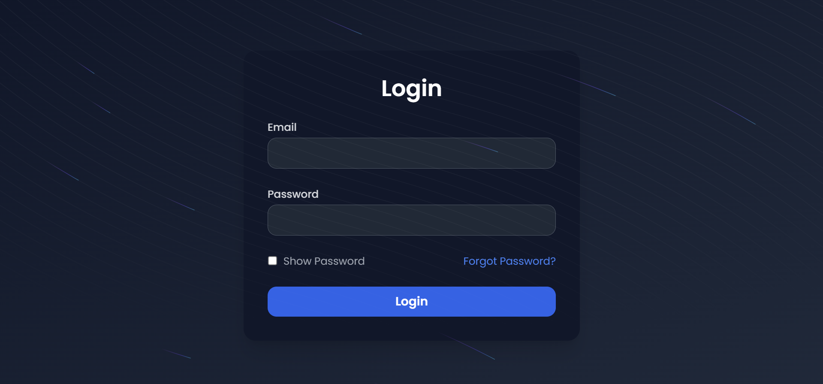

Slide 16
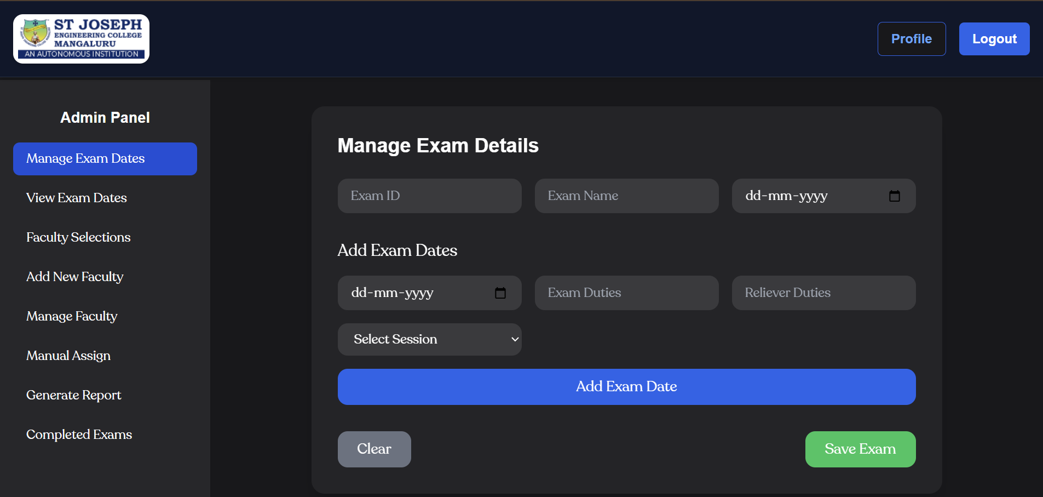

Slide 17
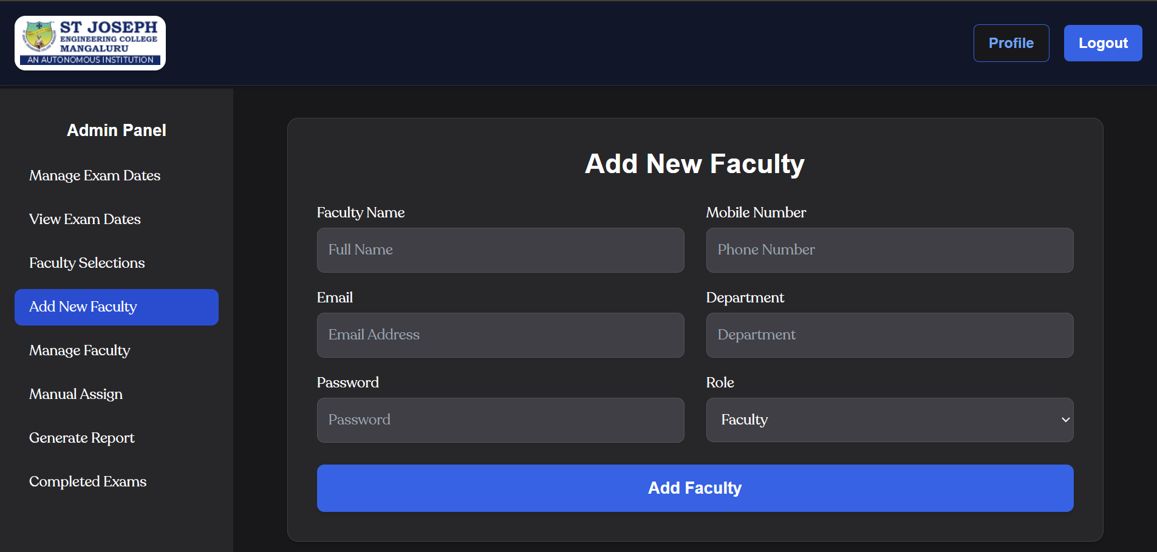

Slide 18
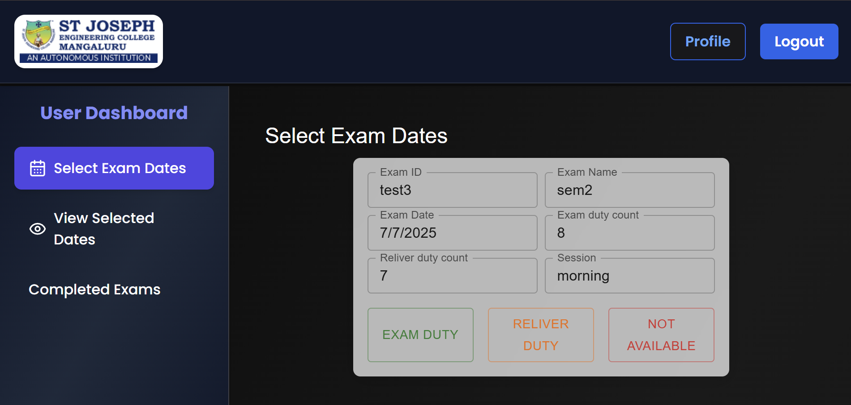

Slide 19
